Slide 1
BPU AMI Data Stakeholder Process Day 1
Aug 16th 2022 9AM – 1PM
Oprysk, Christopher
Heitmann, Paul

Slide 2
Webinar Instruction Page
All attendees will be automatically muted
Questions? Please use the “Q &A” function in Zoom
We will address clarifying questions at the end of each section
Please note that the “Chat” function in Zoom is not available for this meeting, other than to broadcast the registered speakers “on deck”
This meeting is being recorded. A copy of the recording and slides will be made available on the BPU website: https://www.nj.gov/bpu/newsroom/public/

Slide 3
Disclaimer
This presentation is provided for informational purposes only and should not be taken to represent the views of the New Jersey Board of Public Utilities, its Commissioners, or the State of New Jersey. Please be aware that any information presented is subject to change if there are changes to New Jersey statutes, rules, or policies.
All viewers are responsible for ensuring that they rely only on current legal authority regarding the matters covered in the presentation.

Slide 4
Written Stakeholder Comment Guidelines
The deadline for comments on the AMI Data Access MFR is 5:00 p.m. ET on Friday, Sept 30, 2022
Please submit comments directly to Docket No. EO20110716, using the “Post Comments” button on the Board’s Public Document Search tool.
Comments are considered “public documents” for purposes of the State’s Open Public Records Act and any confidential information should be submitted in accordance with the procedures set forth in N.J.A.C. 14:1-12.3.
Written comments may also be submitted to:
Acting Secretary of the Board
44 South Clinton Avenue, 1st Floor
Post Office Box 350
Trenton, NJ 08625-0350
Phone: 609-292-1599
Email: board.secretary@bpu.nj.gov

Slide 5
Stakeholder Comments
Speaking time per person is limited to 5 minutes—please be respectful of other speakers.
The next five speakers are posted in the chat. We will call on speakers in order. If your name is not showing (only a phone number), please raise your hand when it is your turn to speak.
Phone controls for participants
The following commands can be entered via DTMF tones using your phone's dial pad while in a Zoom meeting:
*6 - Toggle mute/unmute
*9 - Raise hand
At the conclusion of our pre-registered speakers list, we will invite additional speakers to raise their hands to speak.

Slide 6
THANK YOU – Let’s continue the conversation paul.heitmann@bpu.nj.gov

Slide 7
1.Customer Ownership and Sharing of Energy Related Data
Customers own their AMI Data.
Utilities use the Green Button Connect (GBC) to authorize customers to access and share their data.
Electronic Data Interchange (EDI) via flat files.

Slide 8
1. Customer Data Sharing (envisioned sequence)
Utility
LIVE
EDI
LIVE
EDI
TP Provider
LLC

Slide 9
1. Customer Ownership and Sharing of Energy Related Data
WHY IS THIS IMPORTANT?
Energy consumption (amounts and their timing) is a valuable source of data for developing and deploying innovative customer management solutions.
Consumers that have a sense of “ownership” for something valuable can seek to monetize that as markets develop for that purpose.
Allowing access to this valuable data to a trusted third party should not be inhibited by complex barriers to authorization/access.
The focus on energy data by definition makes this a customer centric process.

Slide 10
2. AMI Data Provision Timeline
Billable Data shall be available no later than 48 hours after collection.
Un-validated Data shall be available on a 15 second basis
Customers require a qualified energy monitoring device.

Slide 11
2. AMI Data Provision Timeline
WHY IS THIS IMPORTANT?
Energy Data is a highly fungible commodity whose value is maximized when accessed and interpreted shortly after the energy consumption.
Consumers are more likely to respond with behavior changes if the data reflects recent consumption patterns and more closely ties to cause and effect.
A growing trend to increase interest and engagement with energy consumption introduces “game-ification” techniques – which rely on feeds of near real time data for relevance.

Slide 12
3. Adoption of Standardized Customer Privacy and Cybersecurity
Utilities Develop Data Access Plans.
Utilities develop a Common Release Form.
Utilities must provide customers the option to withdraw sharing permission at no cost any time.
Utilities must provide a multi-factor authentication for sharing Data to Third Parties.
Utilities must maintain cybersecurity standards consistent with National Institute of Standards and Technology and industry best practices.
Utilities must maintain a “bad actor” list of banned Third-Party entities.
Utilities must notify the customer, the Board, the Attorney General, and Law Enforcement of any unauthorized release of customer data.

Slide 13
3. Adoption of Standardized Customer Privacy and Cybersecurity
WHY IS THIS IMPORTANT?
Maintaining a high level of consumer trust is critical for the sustained engagement of energy users in adopting potential efficiency and clean energy programs.
Utilities need to incorporate effective best practices for balancing the safeguarding of customer privacy while enabling access to the broadest set of innovative customer services.
Rigorous oversight and correction of violations require a clear policy, adequate monitoring, and well defined processes that assures a continuous improvement of privacy and security.

Slide 14
4. Reporting Metrics
Total Usage kWh.
Number of Customers during period.
Demand Level (kW).
Number of customers granting on going access to providers through GBC.
Number of customers granted one time access to providers through GBC.
Number of customers withdrawing GBC.
Number and type of errors generated in data sharing (customer and third party side).
Data Delivery time.
Web page Load Time.
Time for third parties to complete onboarding with utilities.
Number and type of issues reported by third parties or customers.
Total number and percentage of customers logging into AMI Data Portal.
Total number and percentage of customers receiving messages regarding energy saving tools, usage and or saving tips.
Average and median number of instances customer logged into the data portal during reporting period.

Slide 15
4. Reporting Metrics
+Total number and percentage of customers logging into AMI Data Portal.
+Total number and percentage of customers receiving messages regarding energy saving tools, usage and or saving tips.
+Average and median number of instances customer logged into the data portal during reporting period.
+Number of customers granted on going access through GBC.
+Number of customers granted one time access through GBC.
+Number of customers withdrew permission through GBC.
Total Usage kWh
Demand Level (kW).
Energy Data
Performance Data
Impact Data
Customer Sat
+Data Delivery time.
+Web page Load Time.
+Time for third parties to
complete onboarding with utilities.
Number and type of issues reported by third parties or customers.
+Number and type of errors generated in data sharing (customer and third party side)

Slide 16
4. Reporting Metrics
WHY IS THIS IMPORTANT?
Assuring ratepayers that the AMI investment is beneficial to the broader energy community.
Assuring third party providers that there is a level playing field that encourages their active, trusted participation with access to utility customers, while carefully monitoring their quality and reputation.
Maintaining accountability for utilities to effectively deploy the authorized AMI systems and track and improve their effectiveness throughout deployment.

Slide 17
5. Data Granularity
Commercial/Industrial customers
EDCs collect data in 5 minute intervals.
Residential customers
EDCs collect data in 15 minute intervals initially.
EDCs must be able to easily reconfigure to collect data at 5 minutes to coincide with FERC Order 2222 to allow for DER aggregation.

Slide 18
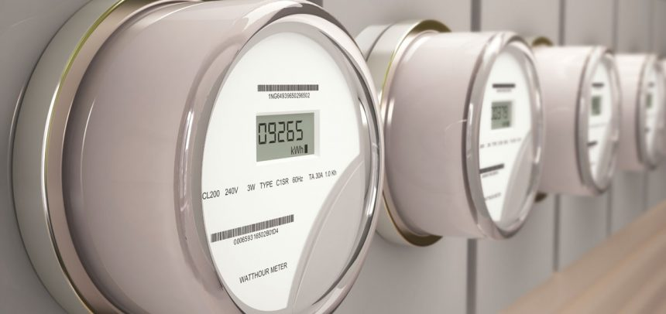
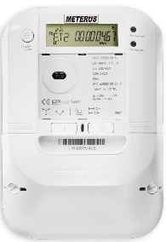
5. Data Granularity
DER Aggregator
5 min.
15 min.

Slide 19
5. Data Granularity
WHY IS THIS IMPORTANT?
The frequency of interval data collection determines which markets may be accessible to these connected energy consumers for a variety of “grid flexibility services”.
Commercial buildings frequently have more sophisticated energy management systems in their HVAC and other process control systems, and can use the more refined data effectively.
The coming rise of DER Aggregators that are enabled under the FERC Order 2222 will require more granular interval data.

Slide 20
6. Additional Data Fields
EV Charging Service Providers.
Status flag of the metered premises as operating within a predefined community.
Volt/Var services.
Additional Data fields relevant for third parties, customers, future development of the industry.

Slide 21
6. Additional Data Fields: Example
Local Energy realtime data feed (HAN)
NOTE: This would embed the
Designation “tag” for the 3rd party accessed energy data.
AMI Data Network
Auth
Community Designation
Smart Meter
AMI Comms
Head End
MDAS
+1
+1
3rd Party Apps
Authorization
Subscription
Data Feed and Hosting for export to App
NOTE: The “tag” could be used to flow in directed incentives as part of 3rd party solutions targeted for these disadvantaged communities. Low overhead and friction
Additional Funding

Slide 22
6. Additional Data Fields
WHY IS THIS IMPORTANT?
The AMI Data Network forms a mesh of edge computing and high bandwidth communications.
This network will increasingly become the “fabric” of the evolving modern grid that absorbs ever increasing levels of DER (some of which is just coming on the scene).
Avoiding stranded asset or reprogramming for this expensive resource requires flexible adaptation.

Slide 23
This Concludes:
BPU AMI Data Stakeholder Process Day 1
Aug 16th 2022 9AM – 1PM
Thank You!
Next Meeting Sept 6th 2022
Please remember to submit comments directly to Docket No. EO20110716, using the “Post Comments” button on the Board’s Public Document Search tool.

